Slide 1
Regional Urban Design Guidelines
Update to FORA Board
September 19, 2014
Josh Metz, Associate Planner

Slide 2
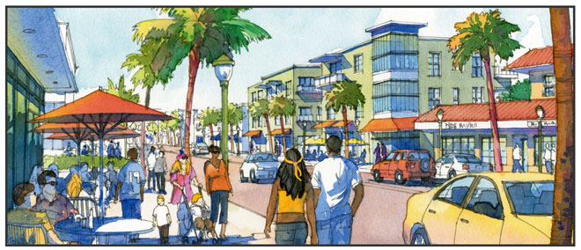
Overview
History
Next Steps
Key Dates

Slide 3
History
1997 Reuse Plan requires Regional Urban Design Guidelines (RUDG)
Highway 1 Design Guidelines approved 2005
Completion of RUDG identified in 2012 Reassessment Report
Value of RUDG highlighted in 2013 Colloquium
2014 Work Plan includes moving ahead with RUDG process
Approved 2014/2015 Budget includes RUDG
Approved Dover-Kohl contract in July 2014

Slide 4
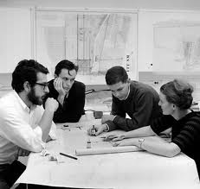
Next Step
Finalize Project Schedule
Hold Start-up Meetings
Initiate Online Engagement
Prepare for Site Visit & Charrette

Slide 5
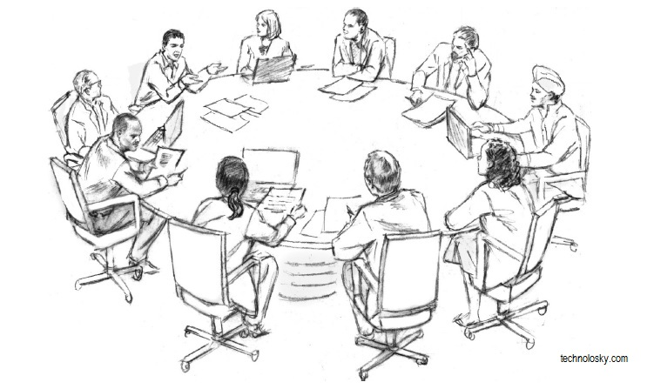
Key Dates
Sept 22: Start-up Meeting
Nov 12-19: Site Visit with Board Meeting
Feb 2-13, 2015: Charrette

