Slide 1
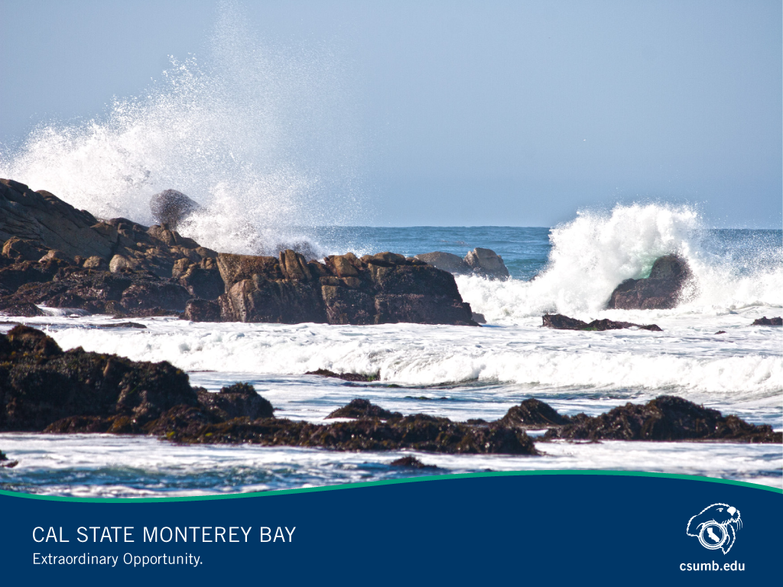
Cal State Monterey Bay
A Place of Extraordinary Opportunity

Slide 2
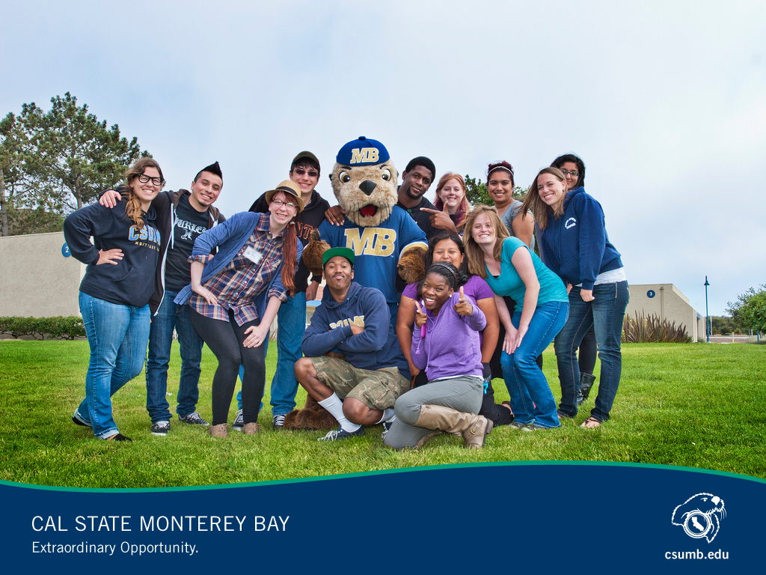
Our Students

Slide 3
Growing Enrollment
Notes:
This fall’s enrollment is more than 6500 students
60 percent increase in new freshmen
18 percent increase in transfers

Slide 4
Where Our Students Come From
35 percent from 3-county service area – Monterey, San Benito, Santa Cruz counties
25 percent from Southern California
Most of the rest from other parts of the state
About 200 international students
Notes:
Tri-County region -- 35 percent
N. California -- 20 percent
Cent. California – 17 percent
Southern California – 25 percent
International students: Matriculating – 2-year or 4-year; Partnership agreements – for a semester or an academic year. World learning students.
Largest numbers of international students are from Germany, Japan and Korea, those in the World Learning program are from Laos, Myanmar, Yemen, Uganda and Tunisia.
Expect international students numbers to continue to grow. CSU guideline __ 10 percent international or out of state.

Slide 5
We welcome students of many ethnicities
57% of our undergraduates are first-generation college students
Notes:
White – 39 percent
Latino – 34 percent
African American – 7 percent
Two or more – 7 percent
Asian American – 5 percent

Slide 6

Ania Flateau
A kinesiology major, Ania was born with spina bifida
Plans to pursue a career in occupational therapy, working with patients with spinal cord injuries
Active in Zumba, wheelchair basketball, ballroom dancing
Volunteers as disability rights advocate

Slide 7
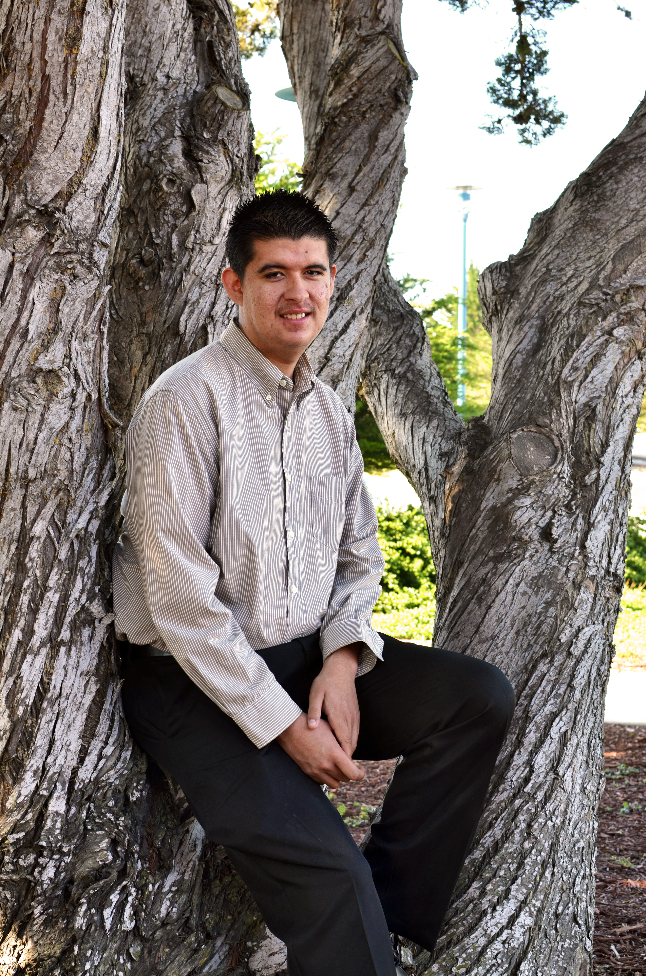
Jesús Ochoa Perez
Winner of CSU Trustees Scholars award
Son of farmworkers, he is starting his second year at CSUMB, where he is a math major with a 4.0 GPA
Service learning requirement led him to an elementary school where he tutored first-graders in math – and discovered his passion for teaching
Plans to earn his credential and return to his East Salinas high school to teach math
Notes:
The trustees award recognizes superior academic performance, personal accomplishments, community service.

Slide 8
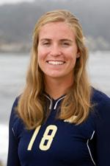
Julia Ashen
Senior honors student, human communications major
In 2013, she became CSUMB’s first volleyball Capital One Academic All-American
Led team that won Team Academic Award from the American Volleyball Coaches Association
Valedictorian of her North Salinas High graduating class
Notes:
Volleyball team won the Team Academic Award from the American Volleyball Coaches Association, one of only four colleges in the West region to win that honor.
CSUMB placed a school–record 62 student–athletes from its 10 CCAA sports on the 2014 All–Academic team, the fifth consecutive season in which the Otters have led the CCAA in All–Academic award winners on a per capita basis.

Slide 9
CSUMB alumni – 10,000 strong
Alumni in all 50 states, the District of Columbia, American Samoa, Puerto Rico and four foreign countries
More than 8,000 around California
Next largest contingents in Oregon, Washington, Texas and Nevada

Slide 10
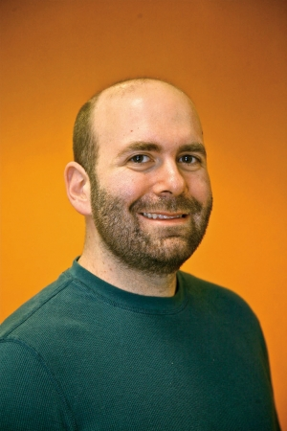
Jakob Heuser
2004: Earned B.A. in Telecommunications, Multimedia & Applied Computing
2008: Completed on-line master’s in Instructional Science and Technology
Joined Silicon Valley start-up LinkedIn in 2008 as one of just 10 on web development team
Now, principal web and user interface developer
Site has almost 200 million unique visitors worldwide each month

Slide 11
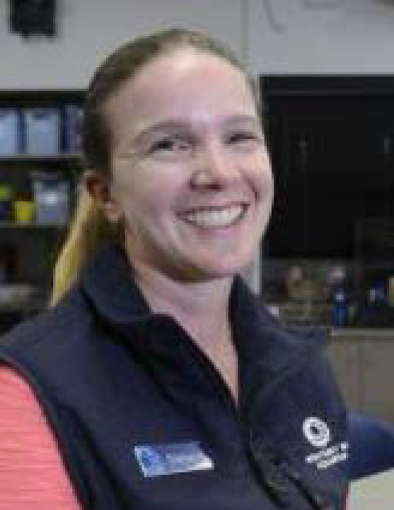
Stefanie Pechan
Fifth-grade teacher in the Pacific Grove Unified School District
One of six teachers chosen as California finalists for the Presidential Awards for Excellence in Math and Science Teaching
In 2001, Pechan earned a bachelor’s degree in liberal studies with an emphasis in computer science and technology at CSUMB
Also a member of the education staff at the Monterey Bay Aquarium

Slide 12
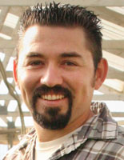
Juan Perez
Earned B.S. in Environmental Science Technology and Policy in 2009
Started J&P Organics, a family run farm and delivery service
Advocates local sustainable agricultural practices
Company provides fresh, organic vegetables and fruits to more than 500 people in three counties, as well as selling at farmers markets
Juan was featured in Mother Nature Network as a favorite young farmer "40 Farmers Under 40,” who are helping nurture a food revolution

Slide 13
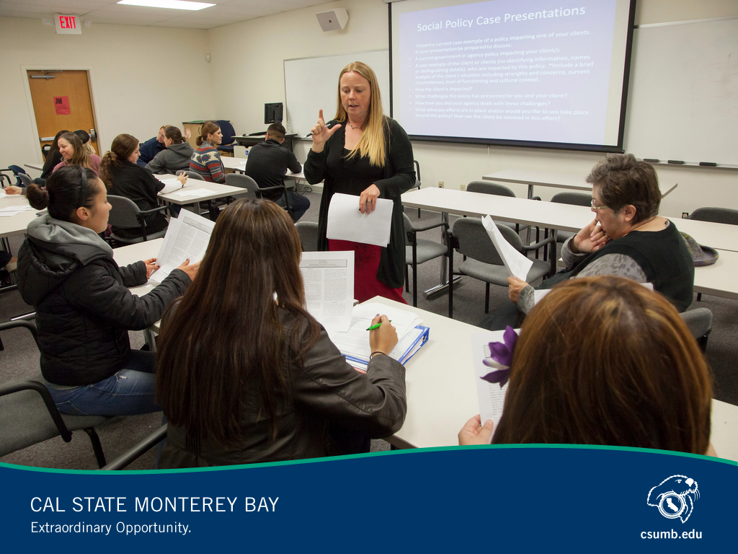
Faculty and Programs

Slide 14
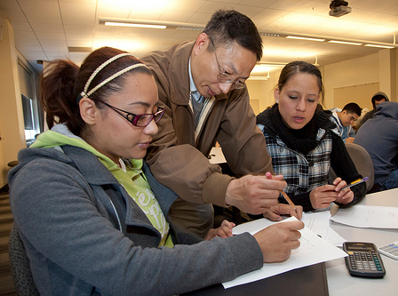
Dr. Hongde Hu
Helped develop Math Boot Camp to prepare students for college studies
Program has served as a CSU-wide model for math remediation
CSUMB was one of only 10 institutions worldwide receive the Ed Tech Innovators Award
Notes:
Prof. Hu also helped develop the university’s outreach program in remedial mathematics, "Leapfrogging Math."
CSUMB was one of only 10 institutions worldwide chosen to receive the Ed Tech Innovators Award.
This financial award has allowed local high school math instructors and students to attend four weeks of math "boot camp" during the summer.
More than 92 percent of students in this program have passed the two-semester course, compared with a national rate of just under 50 percent.

Slide 15
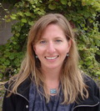
Dr. Cheryl Logan
Assistant professor in Department of Science and Environmental Policy
Lead author of international study showing evidence that coral reefs are adjusting to climate change
Findings reported in the L.A. Times, Monterey Herald, and a number of on-line environmental and science journals
She and four CSU colleagues recently received a $900,000 grant from the National Science Foundation to conduct research on ocean acidification and oxygen levels
Notes:
Published in the journal Global Change Biology.
Worked with scientists from the NOAA and the University of British Columbia
New grant went to five CSU researchers. Received funding support from COAST , now based at CSUMB

Slide 16
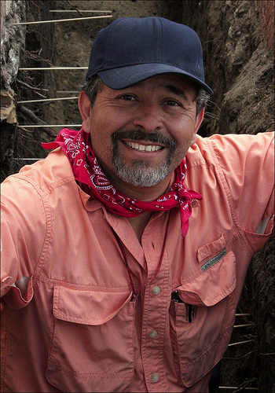
Dr. Rubén G. Mendoza
Prof. Mendoza has directed archaeological investigations at many California missions
Recent efforts in Monterey resulted in the discovery of the earliest Christian churches in California
Worked with two undergrads to win National Endowment for the Humanities grant to teach high school teachers about mission history
Notes:
A founding faculty member of CSUMB, Mendoza has directed major archaeological investigations at a number of California missions.
Recent efforts at the Royal Presidio of Monterey resulted in the discovery of the earliest Serra era Christian houses of worship in California.
Much of the California coast is archaeologically sensitive and contractors need people trained to determine whether a construction area is historically significant. CSUMB prepares students to meet the demand for this kind of work.
$177,000 grant will fund two workshops that will bring teachers to the Central Coast next summer.
The grant, through the NEH’s "Landmarks of American History and Culture" program, was one of only three awarded in California and 22 awarded nationwide.

Slide 17
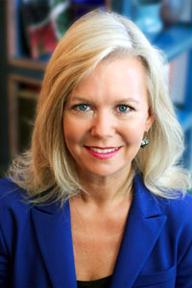
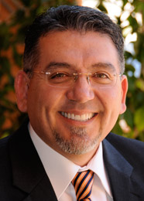
Two new colleges, two new deans
Dr. Britt Ríos-Ellis, Dean of Health
Sciences and Human Services
Dr. José Luis Alvarado,
Dean of Education

Slide 18
Students Choose from
23 Undergraduate + 8 Graduate Majors
Popular Undergraduate Majors:
Business – 13 %
Psychology – 11 %
Kinesiology – 11%
Biology – 10 %
Popular Graduate Majors:
M.A. Social Work – 34 %
M.A. Education – 23 %
M.S. Applied Marine and Watershed Science – 16 %
M.S. Instructional
Science, Technology – 15 %
Notes:
All undergraduate majors
Biology; business administration, collaborative health and human services, communication design, computer science and info. Tech, environmental science tech and policy, environmental studies, global studies, human communication, integrated studies, Japanese, kinesiology, liberal studies, marine science, math, music and performing arts, nursing, psychology, social and behavioral sciences, Spanish, teledramatic arts & technology, visual and public arts, world languages and culture.
Graduate programs
Coastal and watershed science and policy, education, instructional science and technology, marine science, master of public policy, master of social work.

Slide 19
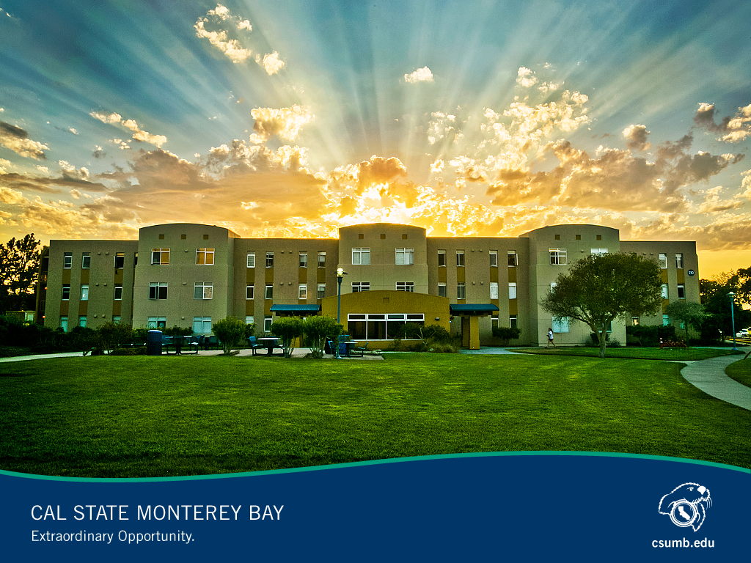
Our Campus

Slide 20
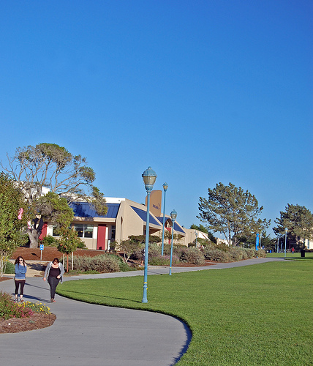
Campus Continues to Grow and Evolve
The former Fort Ord was 28,000 acres
Cal State Monterey Bay covers 1,377 acres of that
The university is housed in 70 buildings, 1.33 million square feet
Campus master plan envisions ultimate enrollment of 12,000 FTE students

Slide 21
Economic Impact
One of Monterey County’s leading employers
Annual CSUMB-related spending generates total impact of $133 million on the regional economy; $269 million on statewide economy
Faculty undertake applied research on regional issues
CSUMB Small Business Development Center has served hundreds of Salinas Valley clients; opened new center last year in Old Town Salinas
Notes:
Spending impact figures come from CSU study in 2010.
Applied research – NASA grant, $32 million, using satellite technology to maximize efficient water use, study impact of climate change
Student internships in agribusiness, computer science, social work and communications add up to 65,000 hours a year.
Research areas include agriculture and water issues, marine science, climate change.
Small businesses benefit from students helping them grow their businesses while learning how the real world works. A win-win.
Institute for innovation and economic development is a partnership with the Monterey County Business Council house on our campus.

Slide 22
A Bright Future
CSU committed to enrollment plans that would allow CSUMB to grow faster
Projected to grow to 8,000 FTE students by 2020, 12,000 by 2024
Plan would increase full-time faculty by one-third by 2020
$30 million for blight removal from the CSU

Slide 23
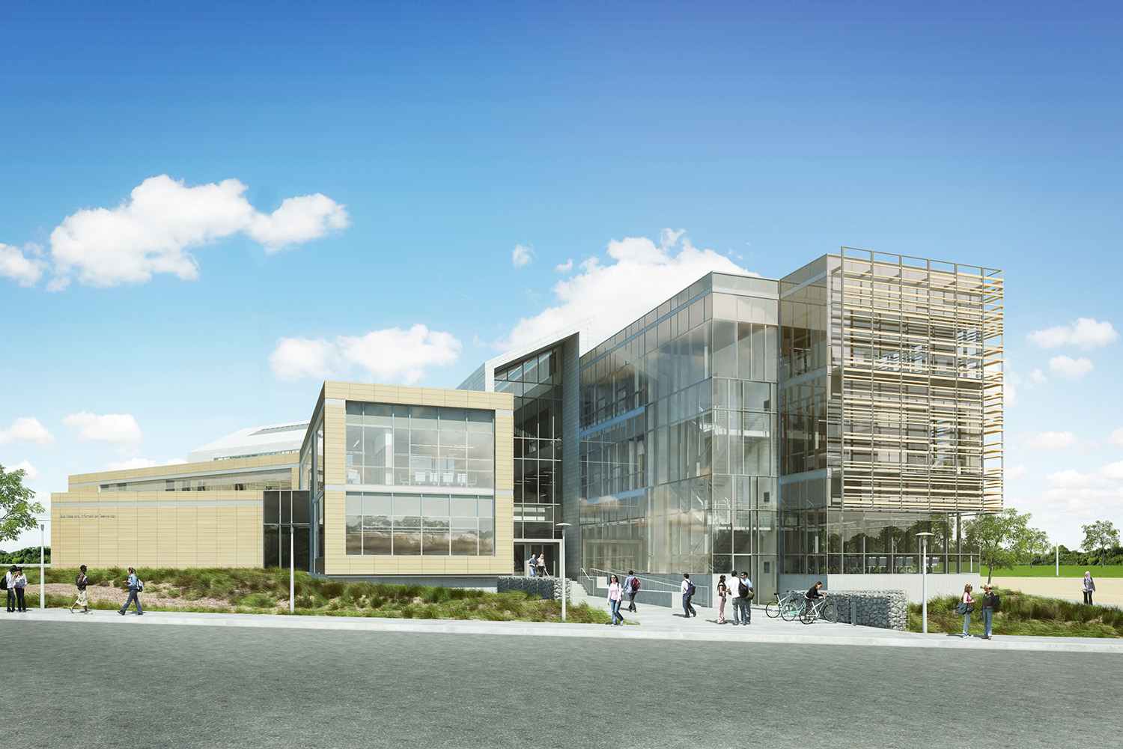
Our Newest Capital Project
The university broke ground last November on a new building to house the College of Business and the School of Information Technology and Communications Design
Notes:
Building will include classrooms, auditoriums, telecom and computer lab space, faculty offices, meeting space and workrooms.
To be funded from a $42M state bond sale

Slide 24
New Directions
Two Past Phases of CSUMB’s Development and the next one:
  1994-2005: Founding, innovative curriculum, some lingering weaknesses
  2006-12: Destination identity, growing institutional capacity, maturing campus
  2012- : Developing CSUMB’s distinctive identity

Slide 25
Promoting regional cultural and economic development
Involvement in FORA
  Colloquium on regional economic development
Cal State Summer Arts
World Theater productions
Bright Futures for Monterey County: Cradle-to-Career Educational partnership
  Co-conveners with United Way, Monterey County Children’s Council, Office of Education, MC Economic Development Committee
  Part of national Strive Network
  Cynthia Nelson Holmsky, Director

Slide 26
President’s Speaker Series
Addressing important issues facing the region
  2012-13 — Disruptive innovation in higher education
  2013-14 — Flourish Monterey County — Economic development; public safety and gangs; Strive Network
  2014-15 — Future of Monterey County

Slide 27
New Community Outreach Sites
Former Monterey Herald building in Ryan Ranch
  Research, professional development programs for Monterey Peninsula
National Steinbeck Center in Salinas (impending)
  Degree completion, continuing education, outreach office, NSC collaboration

Slide 28
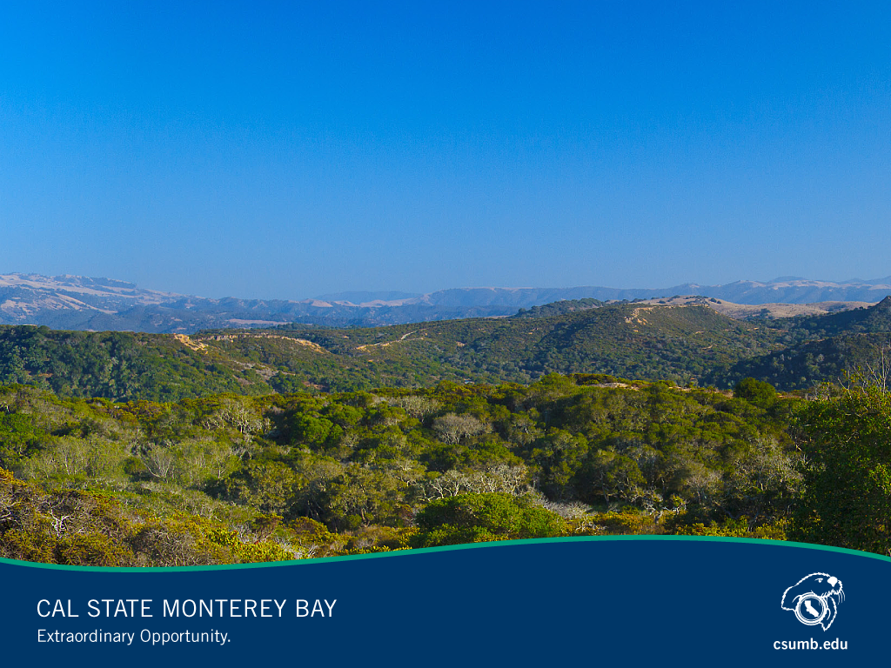
Cal State Monterey Bay. A Place
of Extraordinary Opportunity.

Slide 29
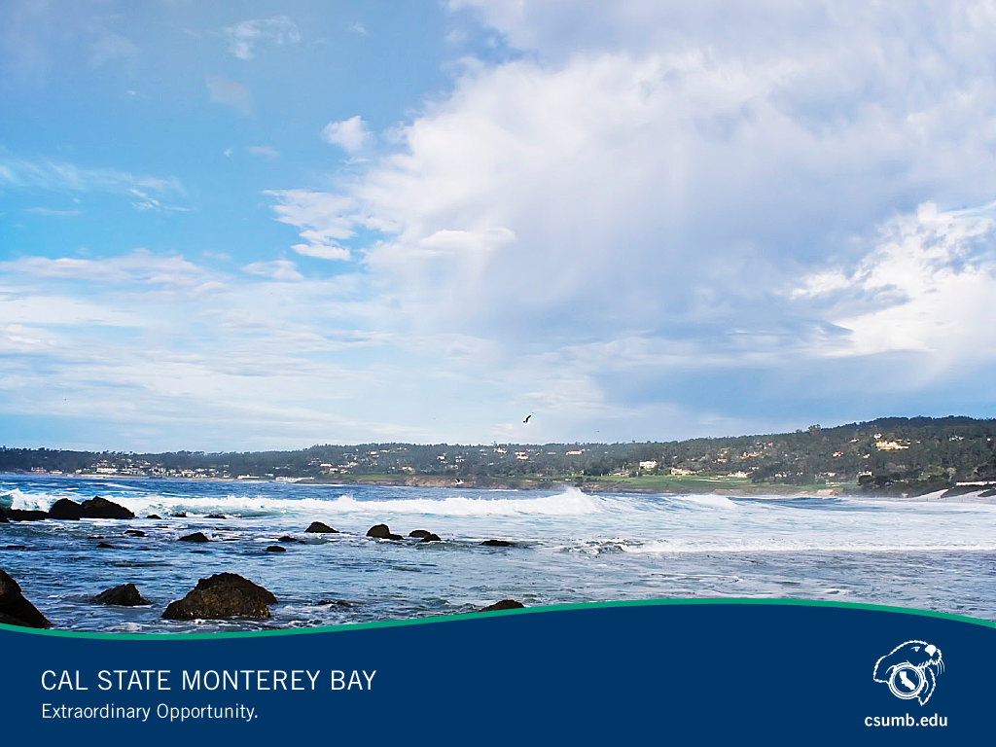
Questions Welcomed

