Slide 1
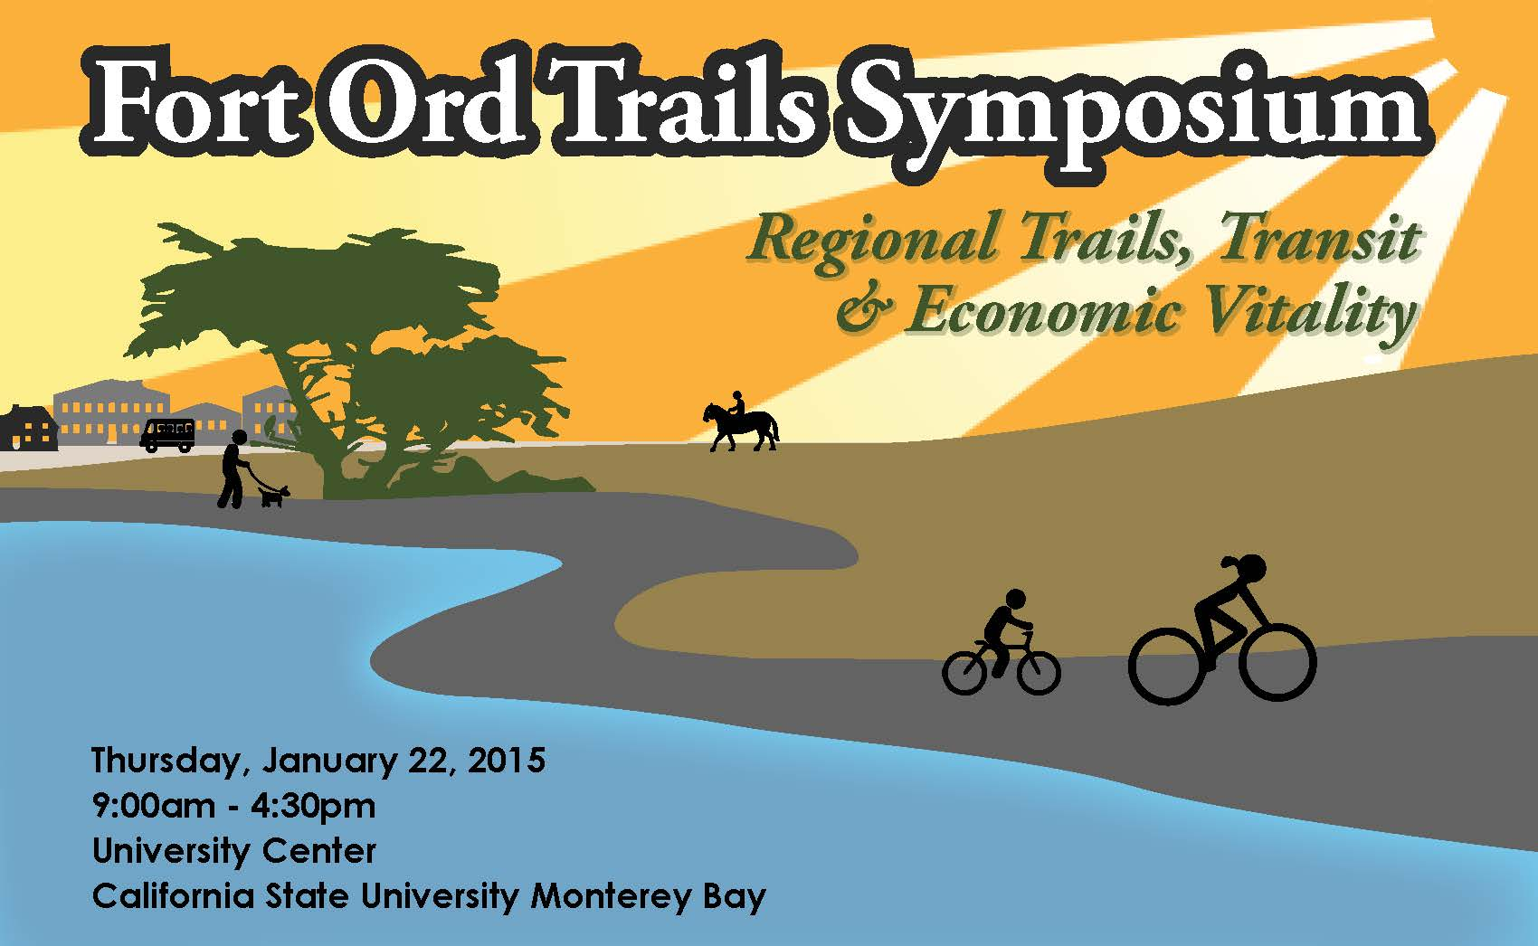
Notes:
How buses, cars, horses, bikes and people get along (profitably)

Slide 2





Fort Ord Trails Symposium
Regional trails, transit & economic vitality
CSUMB University Center
9am-4:30pm
January 22, 2015
Topics:
  Introduction
    Reuse Plan Context
  Economics
    Costs, benefits, funding
  Regional Coordination
    Organizational structure
  Design
    Design considerations
Notes:
Post event reception and tables in lobby for event sponsors
There will be no cost to the public and the event will be publicized through web and social media networks.

Slide 3
Symposium Schedule
  Doors 8:30am
  Welcome 9:00-9:15 am
  Introduction 9:15-9:45 am
    Reuse Plan Context
      Economic Recovery
      Routes, etc.
    Local Planning (FORHA, Marina, Seaside, CSUMB, FORTAG)
    Transportation / Recreation Nexus
  Economics 9:45-11:15 am
    Costs, benefits
      Real estate, employment, income, revenue
      Development costs, insurance, etc.
    Funding (sources, collaboration)
  Local Officials Roundtables 11:15-11:45am
  Networking/Lunch 11:45am-12:15pm
  Keynote Speaker 12:15-1:15pm
  Regional Coordination 1:15-2:45pm
    Multiple outside speakers
    Regional trail development organizations
    Trail connections to/thru Federal / State lands
  Networking 2:45-3:00 pm
  Design 3:00-4:30pm
    Design considerations
    Urban connections
    Multi-use
  Full Panel Q&A 4:30-5:00pm
  Reception 5:00-6:00pm
Notes:
Trails symposium – January 2015
Speakers: Mammoth Lake Trail group, Napa Vine Trail, Tahoe Rim Trail

Slide 4
Speakers
Welcome
  Eduardo Ochoa, CSUMB President
Introduction/Format
  Michael Houlemard, FORA
Local Context
  Josh Metz – FORA
    Reuse Plan overview and regional initiatives summary
Economics
  Tim Blumenthal
    President, People 4 Bikes
    Topic: Improving bicycle transit and economic vitality
  Dena Belzer
    Founder, Strategic Economics
    Topic: Economic benefits of investment in transit, TOD & connectivity
Keynote Lunch Speaker
  Mia Birk
    President, Alta Planning & Design
    Author, Joyride
    Topic: Portlands bike/transit conversion
Regional Coordination
  Laura Thompson, SF Bay Trail
    Association for Bay Area Governments (ABAG) Planner
    SF Bay Trail Project Manager
    Topic: Trail Planning for California Communities
  John Wentworth
    Executive Director, Mammoth Lakes Trails & Public Access
    Topic: Urban-rural trail system planning, development and integration
Design
  Peter Katz
    International Mobility Consultant
    Topic: Alternative transit design & economics
  Bryan Jones, PE, PTP, AICP
    Senior Associate
    Alta Planning + Design
    Topic: Trail system design issues

Slide 5
Budget
CSUMB Event Fees: $8,500
Speaker Stipends: $9,000
Lodging/Travel: $4,000
Video Services: $3,500
Not To Exceed Total: $25,000

