Slide 1
Regional Urban Design Guidelines (RUDG)
Update v1.0
Josh Metz, Associate Planner

Slide 2
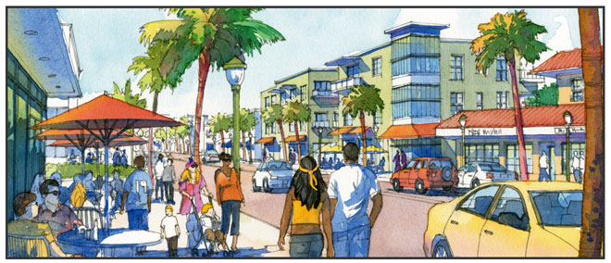
RUDG Update v1.0
Context
Progress
Next Steps

Slide 3
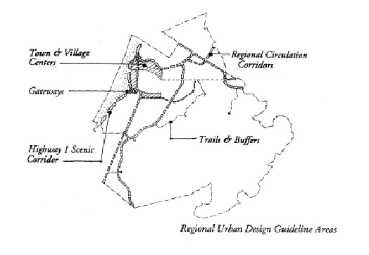
Context
1997 Base Reuse Plan (BRP) requires creation of RUDG for:
  Highway 1 Corridor
  Town & Village Centers
  Regional Circulation Corridors
  Trails Network
  Gateways
Highway 1 Corridor Design Guidelines approved (2005)
Reassessment identified RUDG as outstanding FORA obligation (2012)
FORA Board approved 2014 Work Plan including completion of RUDG

Slide 4

Progress: Committees & Task Force
Administrative Committee (3/5/14)
  Recognize value and issue complexity
  RUDG delivery timing to minimize project review & approval disruption
Post-Reassessment Advisory Committee (3/6/14 & 4/10/14)
  Discuss design role in economic recovery & job creation
Task Force Appointments
  Marina, Seaside, Del Rey Oaks, Monterey City & County
  Board members Beach & Pendergrass
  First meeting: Tues 4/22

Slide 5

Progress: Staff Follow-thru
Consultant selection process
  2-stage proposal solicitation
  Request for Qualifications (RFQ) > Request for Proposals (RFP)
  Structured to produce high value proposals
RFQ Released 3/21/14. Deadline 4/15/14 5:00pm
  Seeking qualified service providers
  Submissions to be reviewed by RUDG Advisory Task Force
Received ADMIN & PRAC input

Slide 6
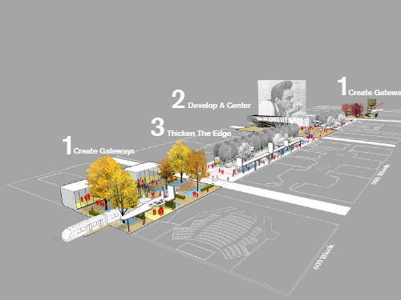
Next Steps
First Meeting of RUDG Task Force
Develop Request for Proposals (RFP)
Receive Statements of Qualification (SOQ)
Task Force reviews RFP, SOQ’s & selects finalists
Consultants present submittals
Task Force recommends teams to Executive Officer/Board
Commence RUDG Process

Slide 7
BRP Re-assessment Category 3 Update

Slide 9
2014 Work Plan
Approved by Board 2/13/14
Includes a focus on completion of Category 3 Items
Regional Urban Design Guidelines – outstanding FORA obligation
Category 3 in Final Reassessment Report (FRR) outlines all remaining items for jurisdictions & FORA

Slide 10
Category 3: Implementation of Policies & Programs
Policies and programs identified in the Scoping Report as incomplete
  Some are incomplete because events that would trigger implementation have not yet occurred.
  Other are not contingent on triggering events, and should be implemented as soon as feasible.
  Details see FRR p3.32-3.68

Slide 11
Table 11
Jurisdiction | Policy/Program Count
City of Marina | 47
City of Seaside | 43
City of Del Rey Oaks | 2
Monterey County | 73
FORA | 6
Meetings to obtain status updates from jurisdictions underway
Notes:
We’re aware that some preliminary meetings that have already taken place, and progress on these items have already been made. As such our interest is to review the items included in the report and get up to date on the status of each.

Slide 12
Completion Process
FORA & Jurisdiction Staff Meetings to Review Cat 3 Items
Return revised list to Admin for Review
Pass recommendations to Board
Schedule/complete any necessary actions
Notes:
List returns to admin with smaller set showing completed, then elevated to Board with recommendation that it be accepted as complete

