Slide 1


Fort Ord Reuse Authority
Habitat Conservation Plan (HCP) Governance/Implementation
September 4, 2013 Presentation
Jonathan Garcia
Senior Planner

Slide 2

What is an HCP?
Section 9 of the Endangered Species Act (ESA) prohibits importing, exporting, taking, transporting, or selling fish and wildlife species listed as endangered (“Take” is the action of or attempt to hunt, harm, harass, pursue, shoot, wound, capture, kill, trap, or collect a species).
Section 10(a)(2)(A) of the ESA allows take of listed species provided certain conditions are met, such as habitat conservation plan, etc.
An HCP is required to secure Section 10 Incidental Take Permit (covers take of listed species)

Slide 3

Regional HCP Structure
US Fish and Wildlife Service (USFWS) and California Department of Fish and Wildlife (CDFW) issue Incidental Take Permits (ITPs)
ITPs issued to 12 local agencies and 1 JPA
Agencies receive take authorization for covered activities: Habitat Management, projects, etc.
Private projects receive “certificates of inclusion” take authorization

Slide 4
Draft Fort Ord HCP
Provides conservation and enhancement framework for 19 special status plant and animal species (HCP species) and their natural communities.
Serves as basis for federal and state Incidental Take Permit (ITP) issuance.
Establishes “covered activities” for three general land use categories:
    Designated development areas
    Borderlands
    Habitat Management Areas

Slide 5
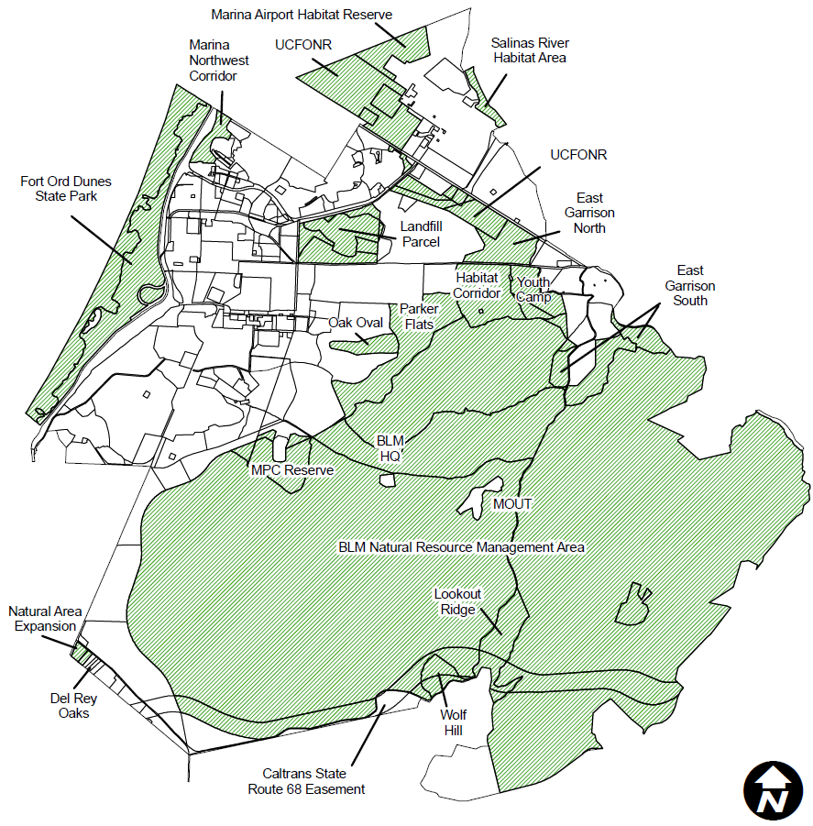

Slide 6
HCP Implementing Agreement
Draft agreement among 13 Permittees, 2 Wildlife Agencies, and Bureau of Land Management (BLM)
Identifies Parties’ obligations
  Permittees fund and implement HCP (including habitat preservation, habitat management, habitat restoration, monitoring, reporting, adaptive management).
  BLM funds and implements habitat management activities on its property (as HCP cooperating entity).
  Wildlife Agencies provide take coverage to Permittees for “covered activities.”

Slide 7
Joint Powers Authority (JPA)
Draft Agreement among 12 Permittees and BLM to create the Fort Ord Regional Habitat Cooperative (Cooperative) to implement the Fort Ord HCP
Cooperative’s purpose
  Fullfill HCP/Implementing Agreement obligations
  Secure, manage, and expend funds to implement HCP
  Oversee, monitor, and report on HCP implementation
  Manage Habitat Reserve System defined
  Provide HCP public information and outreach
  Exercise enforcement & implementation powers (Section 6 of JPA agreement)

Slide 8
Cooperative Governing Board
Consists of 13 voting members and 3 non-voting members
Non-voting members include FORA, MPRPD, and BLM
JPA agreement reserves acreage of take for non-voting members (except for BLM) until all habitat acres transfer from Army to recipients

Slide 9
Mitigation/Trust/Recipient Agreement
SB 1094 (Kehoe) became effective in January 2013, clarifying CDFW’s financial assurances requirements
Assurances agreements define relationships among: habitat management area (HMA) land owners, habitat managers, HCP endowment holders, and financial institutions
Our HCP proposes multiple HMA land owners, two endowment holders (UC and Cooperative), and two financial institutions
Agreement drafted by FORA special counsel

Slide 10
Draft HCP Ordinance/Policy
Provides for FORA Community Facilities District (CFD) Special Tax collection to fund HCP endowments
Describes certificate of inclusion procedures for Permittees to extend take to third-parties

Slide 11
HCP Documents/Operational Relationships
HCP
Permittees
USFWS/
CDFW
HCP Implementing
Agreement
HCP
Implementation
JPA
Agreement
Findings
Mitigation/
Trust/Recip.
Agreement
Implementing
Ordinance/Policy
Section 10 &
2081 ITPs
Take Authorization/
Certificate of Inclusion

Slide 12
Questions?

