Slide 1

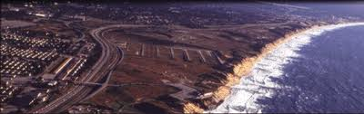
Fort Ord Reuse Authority
FORA/CSUMB Building Removal Business Plan Grant Application
September 13, 2013 Board Presentation
Stan Cook
Real Property & Facilities Manager

Slide 2
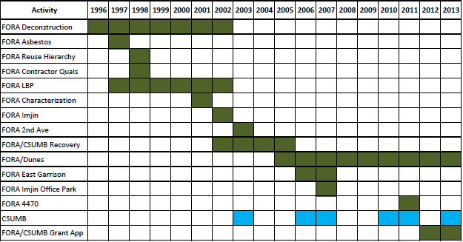
FORA/CSUMB Building Removal

Slide 3
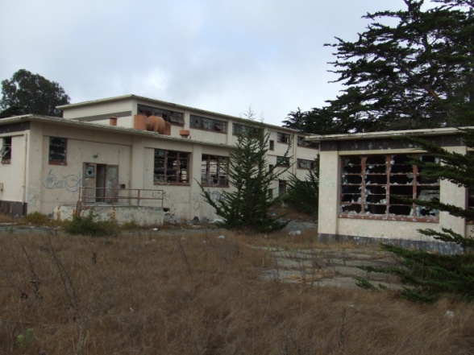
Grant Application Site

Slide 4
Grant Application Scope
DOD Office of Economic Adjustment/DOC Economic Development Administration
Joint FORA/CSUMB Grant Application (FORA Lead)
Develop 65 Building Removal Plan (26 Seaside/39 CSUMB)
Concrete Structures
Complicated by Asbestos/Hazardous Materials

