Slide 1
Capital Improvement Program
FY 2013/14
Presentation to the
Fort Ord Reuse Authority
Board of Directors
June 21, 2013

Slide 2
Capital Improvement Remaining Obligations
Mitigations funded by CFD fees | FY 13/14 Amount
Transportation/Transit | $116,186,689
Water Augmentation (CEQA) | $23,452,781
Water Augmentation (voluntary) | $21,655,302
Storm Drainage System (3 outfalls removed) | $0/Obligation met
Habitat Management | $33,437,419
Fire Rolling Stock | $116,000
Other Costs & Contingencies | $49,000,621
Basewide obligations funded by Land Sales | FY 13/14 Amount
Building Removal Program | $6,200,000

Slide 3
Transportation/Transit
12/11/09 Board direction elevated Eastside Parkway funding to higher priority
  Construction expected after munitions cleanup work completed, CEQA performed, and project funding secured, anticipated in 2014/15 and 2015/16
Current funding priority is given to:
  Project 2b (Davis Road Bridge south of Blanco) – FORA-County reimbursement agreement in place; funds are being used as a grant local match
  Project FO14 (South Boundary Road Upgrade) – Project cost is within grant range; funding available likely for a local match

Slide 4
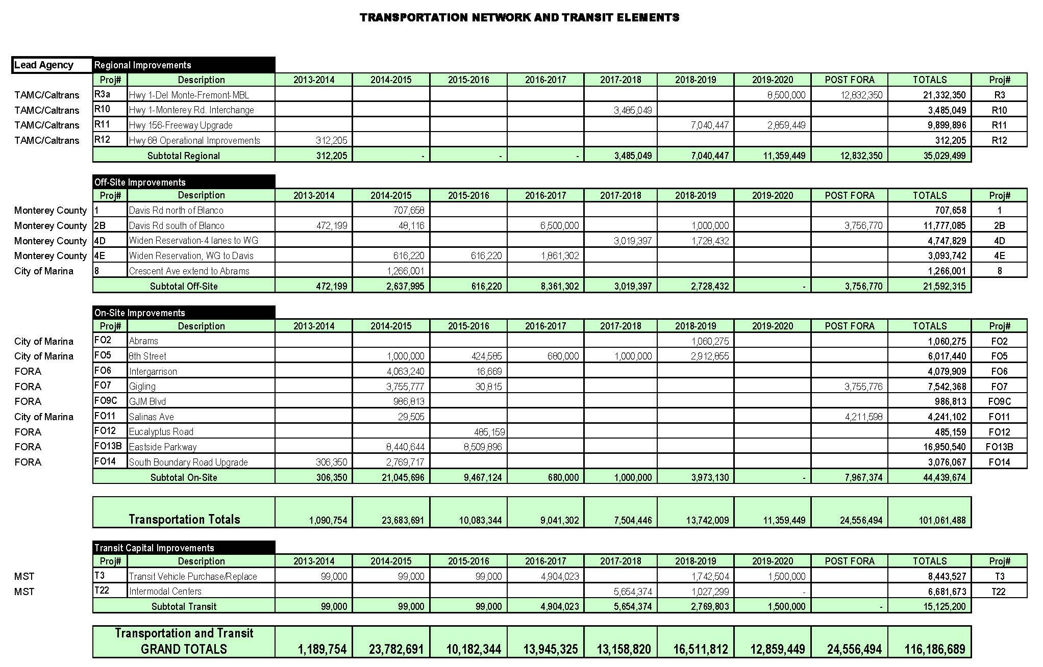

Slide 5
Water Augmentation
$23,452,784 CEQA mitigation included in BRP
$21,655,302 FORA Board-approved (voluntary) contribution to buy down MCWD connection fees
  FY 05/06 CIP adopted, FORA Board approved $17M contribution to “buy down” connection fee
  Original amount indexed to current amount through FY 11/12
  MCWD scheduled to complete new rate study by September 2013

Slide 6
Habitat Management
25% of development fee collected builds endowment
  $39M total endowment; $5.6M collected to date; $33.4M remains to be collected
  $19.2M contingency, final amount will be based on actual payout rate allowed by the CA Dept. of Fish & Wildlife (CDFW)
Ongoing negotiations with the USFWS and CDFW
Total HCP endowment to produce $1.7M per year

Slide 7
Other Costs & Contingencies
Caretaker Costs
  During Phase II Review, this obligation was revised to $660,000 annually based on past caretaker costs (Army-Jurisdictions)
  $660,000 annual caretaker cost is deducted from land sales revenue, provided funding available and costs demonstrated
Additional CIP Costs
  $16.9M - potential and unknown additional basewide expenditures not included in current cost estimates for transportation projects (i.e. contract change orders to ESCA, project changes, etc.)
Habitat Management
  $19.2M - dependent on payout rate allowed by CDFW
Additional Utilities & Storm Drainage
  $3.5M - removal of retention ponds and restoration of the dunes, reporting requirements, potential utility relocation costs due to CIP projects
Other Costs (Debt Service)
  $8.2M – Loan principal and interest and match for General Jim Moore Blvd.

Slide 8
Building Removal Program
Funded from land sale revenue and/or credited against land sale valuation
  2005 MOA with the City of Marina - $46M in building removal costs within the Dunes on Monterey project area
  2006 MOA with Monterey County - $2.1M in building removal costs within the East Garrison project area
FORA’s remaining building removal obligations include the former stockade (±$2.2M) and specific, selected buildings in the City of Seaside “Surplus II” area (±$4M)

Slide 9
Recommendations
6-13-2013 Staff Report: Adopt FY 13/14 FORA CIP
6-19-2013 Administrative Committee motion: Postpone consideration of FY 13/14 FORA CIP until August 9, 2013 FORA Board meeting to allow additional review
Administrative Committee identified four areas of concern requiring study: 1) Post-FORA implications, 2) CIP funding and project placement, 3) building removal credits, and 4) CIP narrative

Slide 10
Questions?

