Slide 1
Capital Improvement Program
FY 2013/14
Presentation to the
Fort Ord Reuse Authority
Board of Directors
July 12, 2013

Slide 2
Recent Actions
6-21-2013 Board received the FY 13/14 FORA CIP; accepted Administrative Committee (AC) recommendation for additional AC review of four areas of concern: 1) Post-FORA implications, 2) CIP funding and project placement, 3) building removal credits, and 4) CIP narrative
7-2-2013 AC meeting, progress made resulting in an updated memo re Post-FORA options, building removal credits included in CIP, and suggestions for additional text improvements to enhance reader understanding
7-2-2013 Executive Committee recommended FORA Board approval of the FY 13/14 CIP

Slide 3
Recent Actions/Next Steps
Staff met with the jurisdictions, Marina Coast Water District and other stakeholders
Staff will continue to refine contingencies and CIP narrative, attempt to fund the water/wastewater collection system contribution sooner
Text additions and next steps will be reviewed/ discussed at the July 17th Administrative Committee meeting

Slide 4
Post-FORA Implications
Responsibilities that survive FORA’s sunset:
  Habitat Conservation Plan implementation
  Base Reuse Plan compliance (CEQA mitigation measures)
  Building removal
  Water purveyor service agreement/augmentation/allocations
Options to perform post-FORA obligations:
  Assign responsibilities to an existing agency
  Assign responsibilities to FORA member agencies, regional and state agencies
  Create a JPA, modify an existing JPA, create a Community Services Area governed by the Board of Supervisors
  Create a FORA “shell” that maintains existing funding structure

Slide 5
CIP Funding & Project Placement
On average, 22% of projected fee has been collected
50% of projected fee was collected in 2012/13
2013/14 land use projections as submitted
2014/15 – 2019/20 projections reduced by 50%, remaining 50% in post-FORA category

Slide 6
Building Removal Credits
Previously, the AC requested further review concerning how FORA Building Removal credits are described in the CIP text and Table 3
FORA staff made clarifying changes to CIP text and Table 3 describing these credits and expenditures

Slide 7
CIP Narrative
Staff will continue to work with the Administrative Committee to improve the text and enhance reader understanding

Slide 8
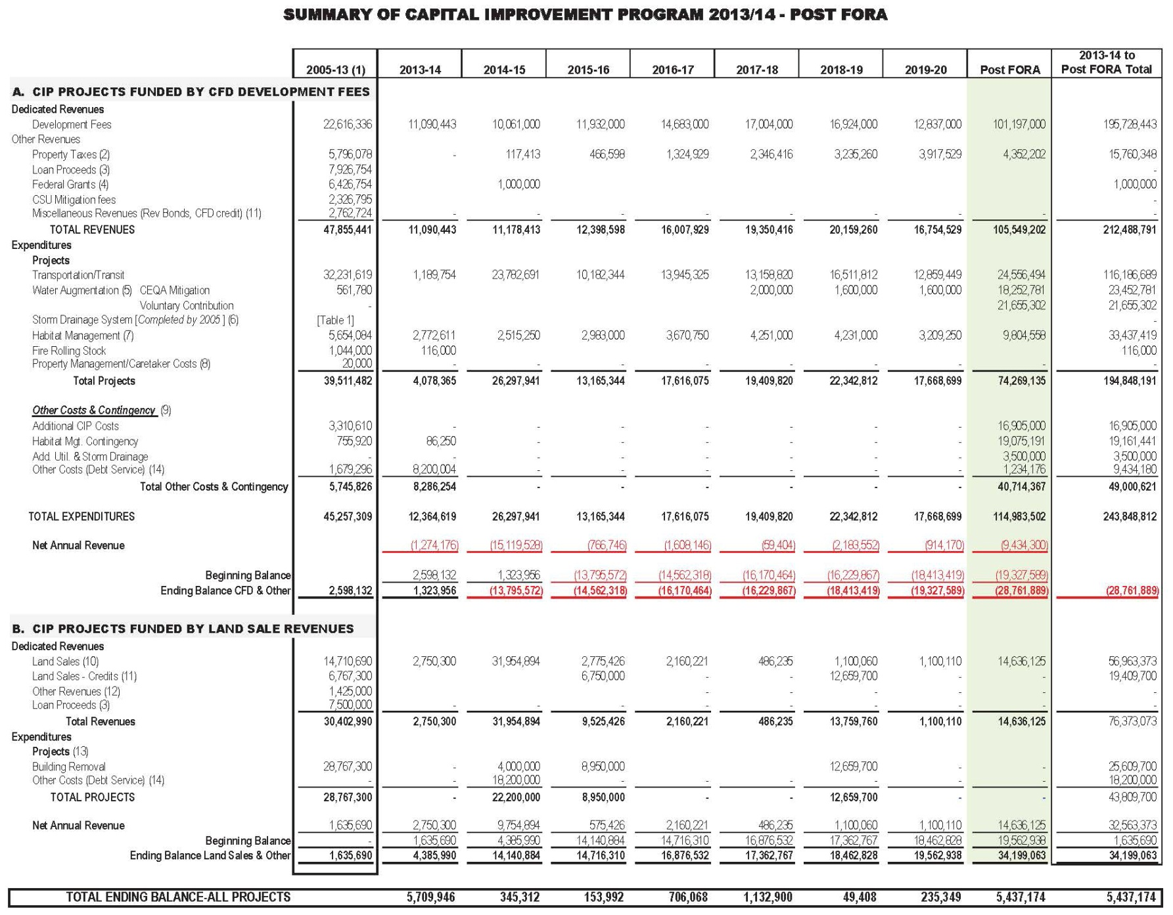

Slide 9
Requested Action
Receive status report on Administrative Committee progress
Provide direction to staff regarding CIP adoption

