Slide 1

Fort Ord Reuse Authority (FORA)
Environmental Services Cooperative Agreement (ESCA)
Remediation Program (RP)
ESCA Remediation Program Update
Presentation by:
Stan Cook, Program Manager
July 12, 2013 Board of Directors Meeting
1

Slide 2
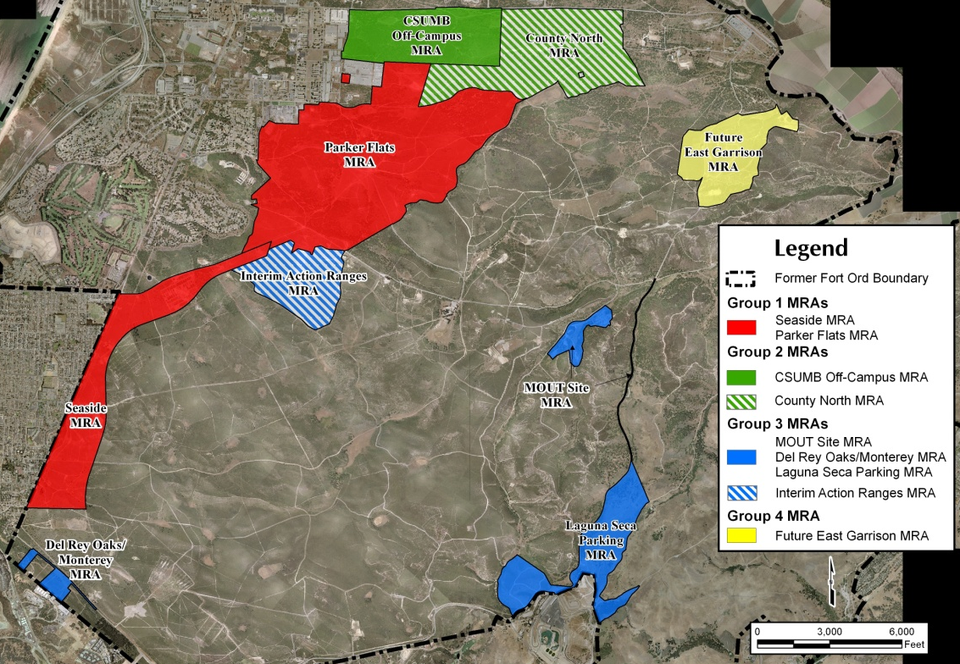
ESCA Munitions Response Areas by Group
4

Slide 3

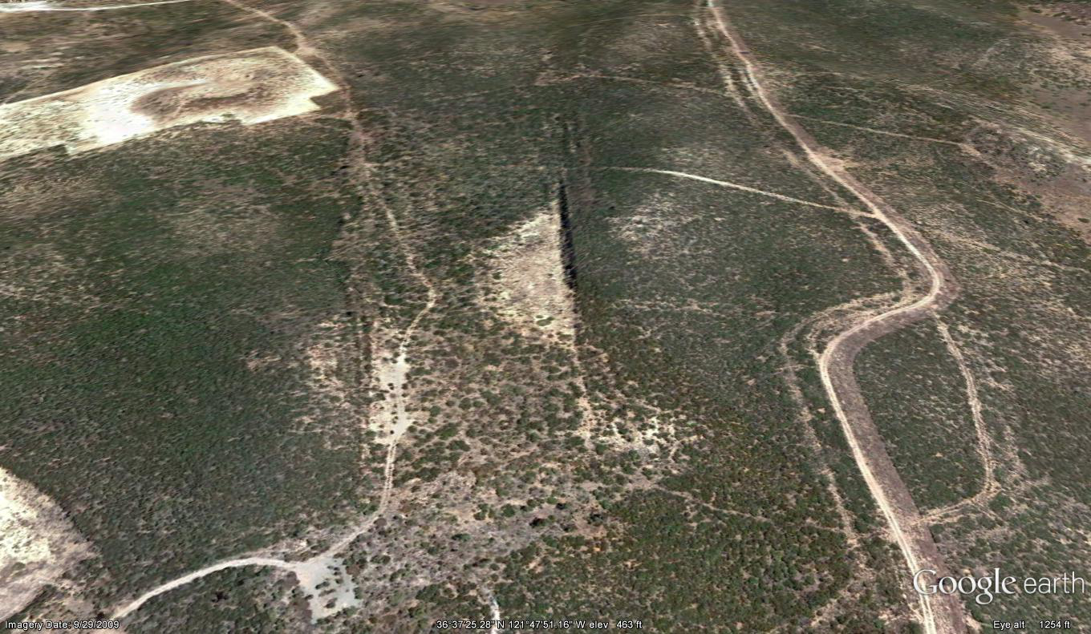
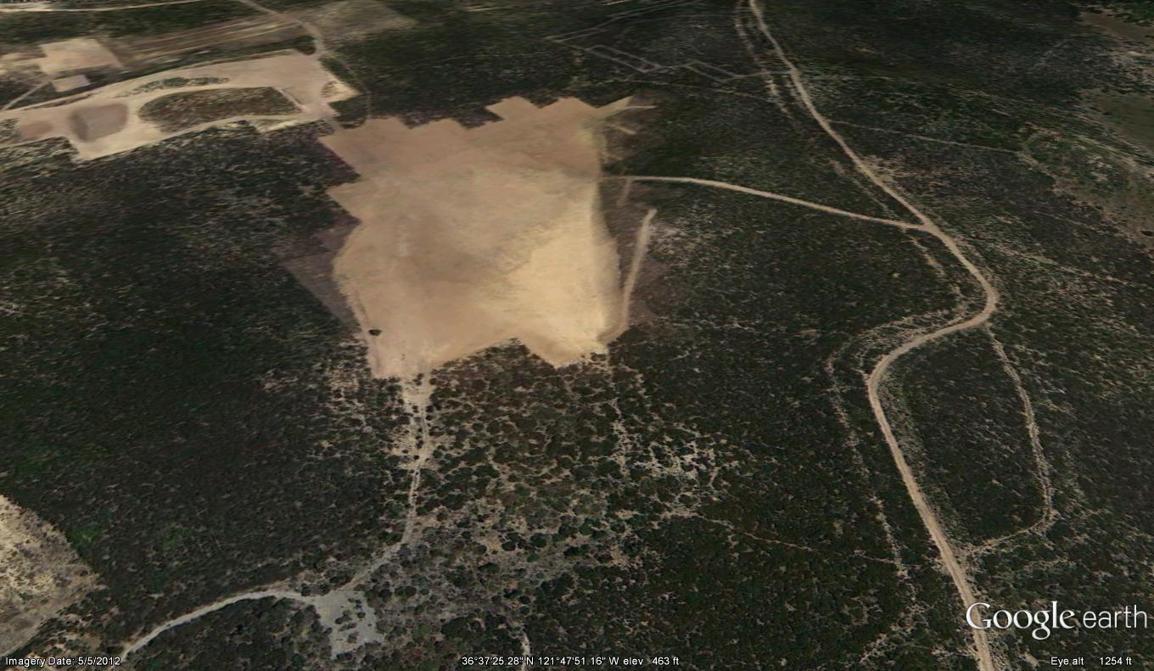
IAR MRA Range 47: Pre/Post Remediation
6
Notes:
Talking Points:
Excavation depth range: approx. 6” – 36”
Total soil screened (including design study and berm): approx. 44,000 yd3
Phased soil removal and soil management program to promote habitat restoration
Soil Screening
40mm HE MEC: 163
40mm MD: 7,637 lbs
Other MEC: 142
Other MD: 4,152 lbs
Other debris: 3,550 lbs

Slide 4
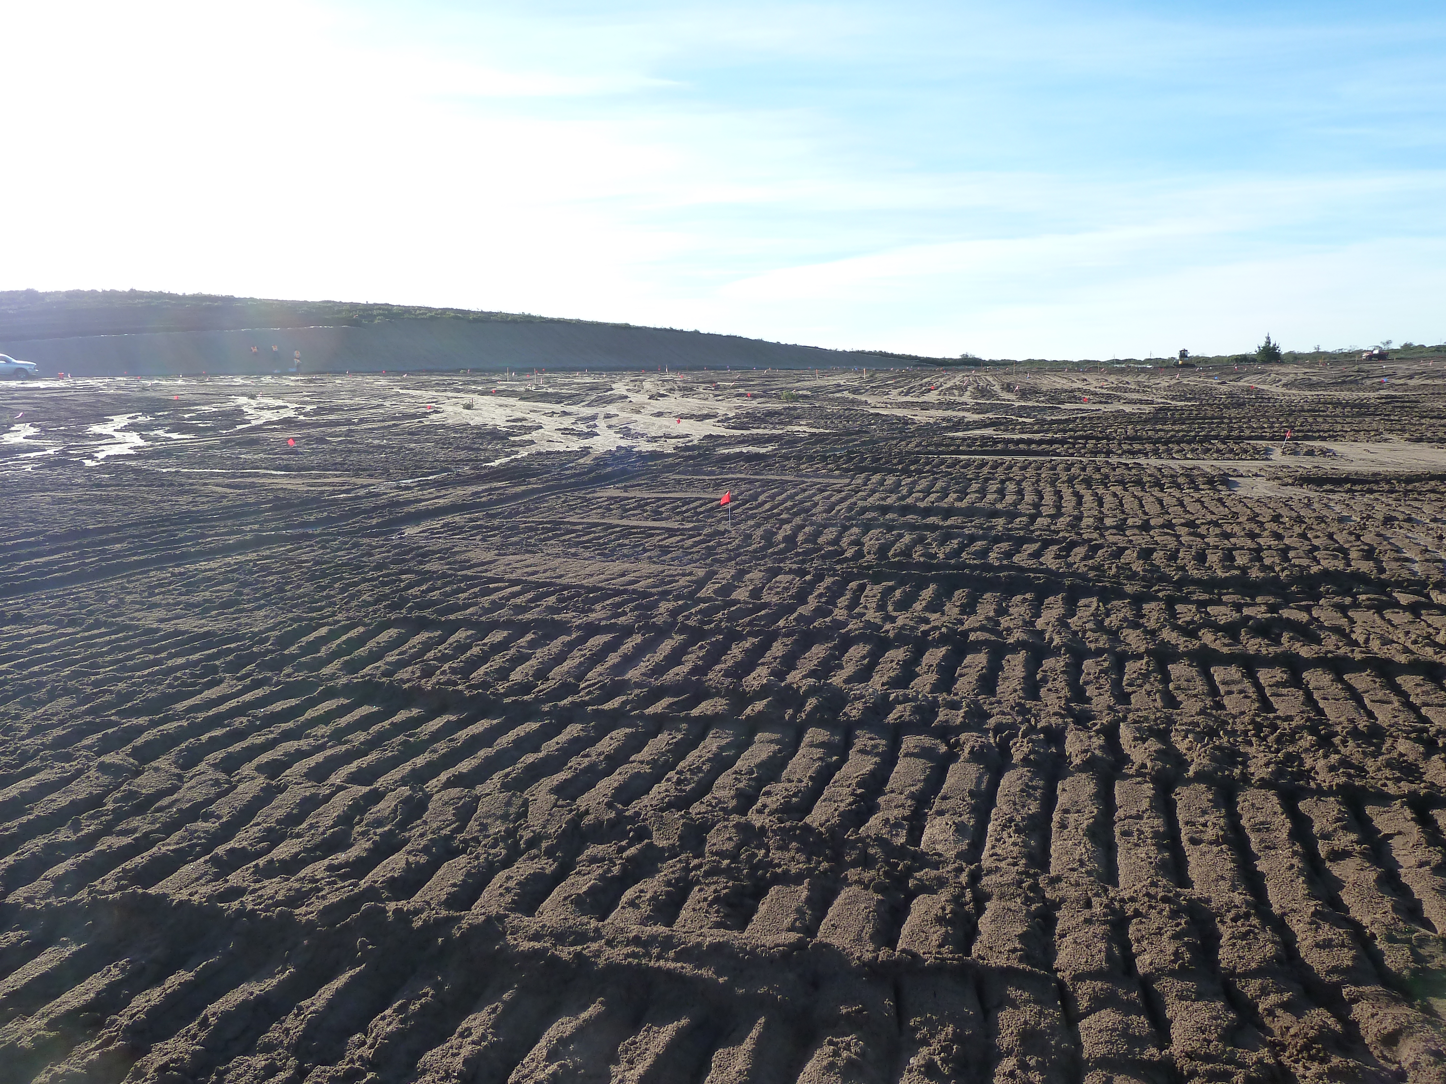
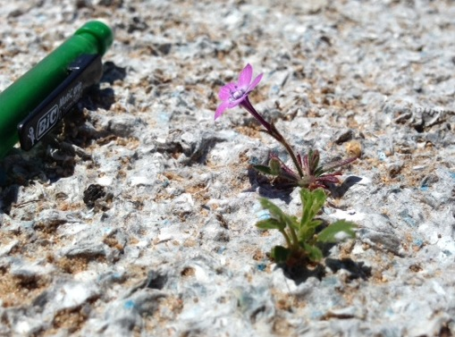
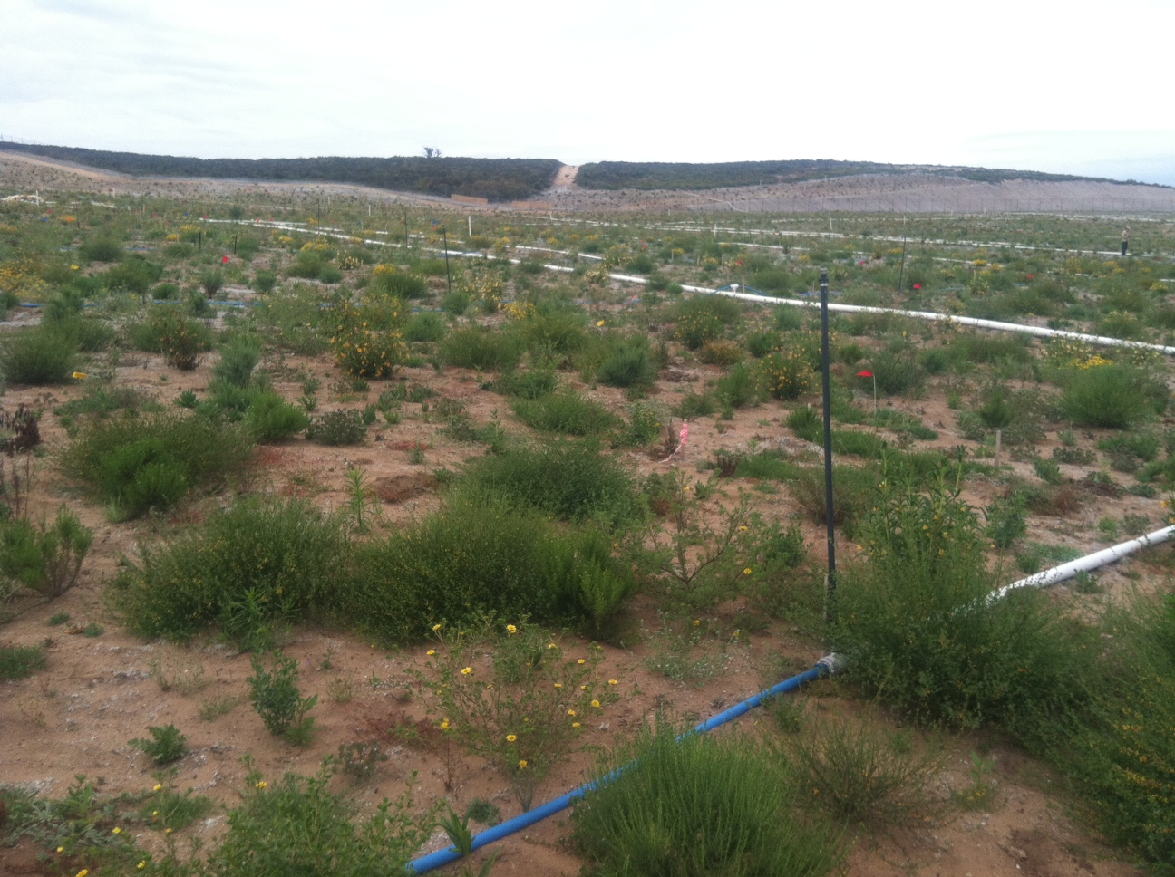
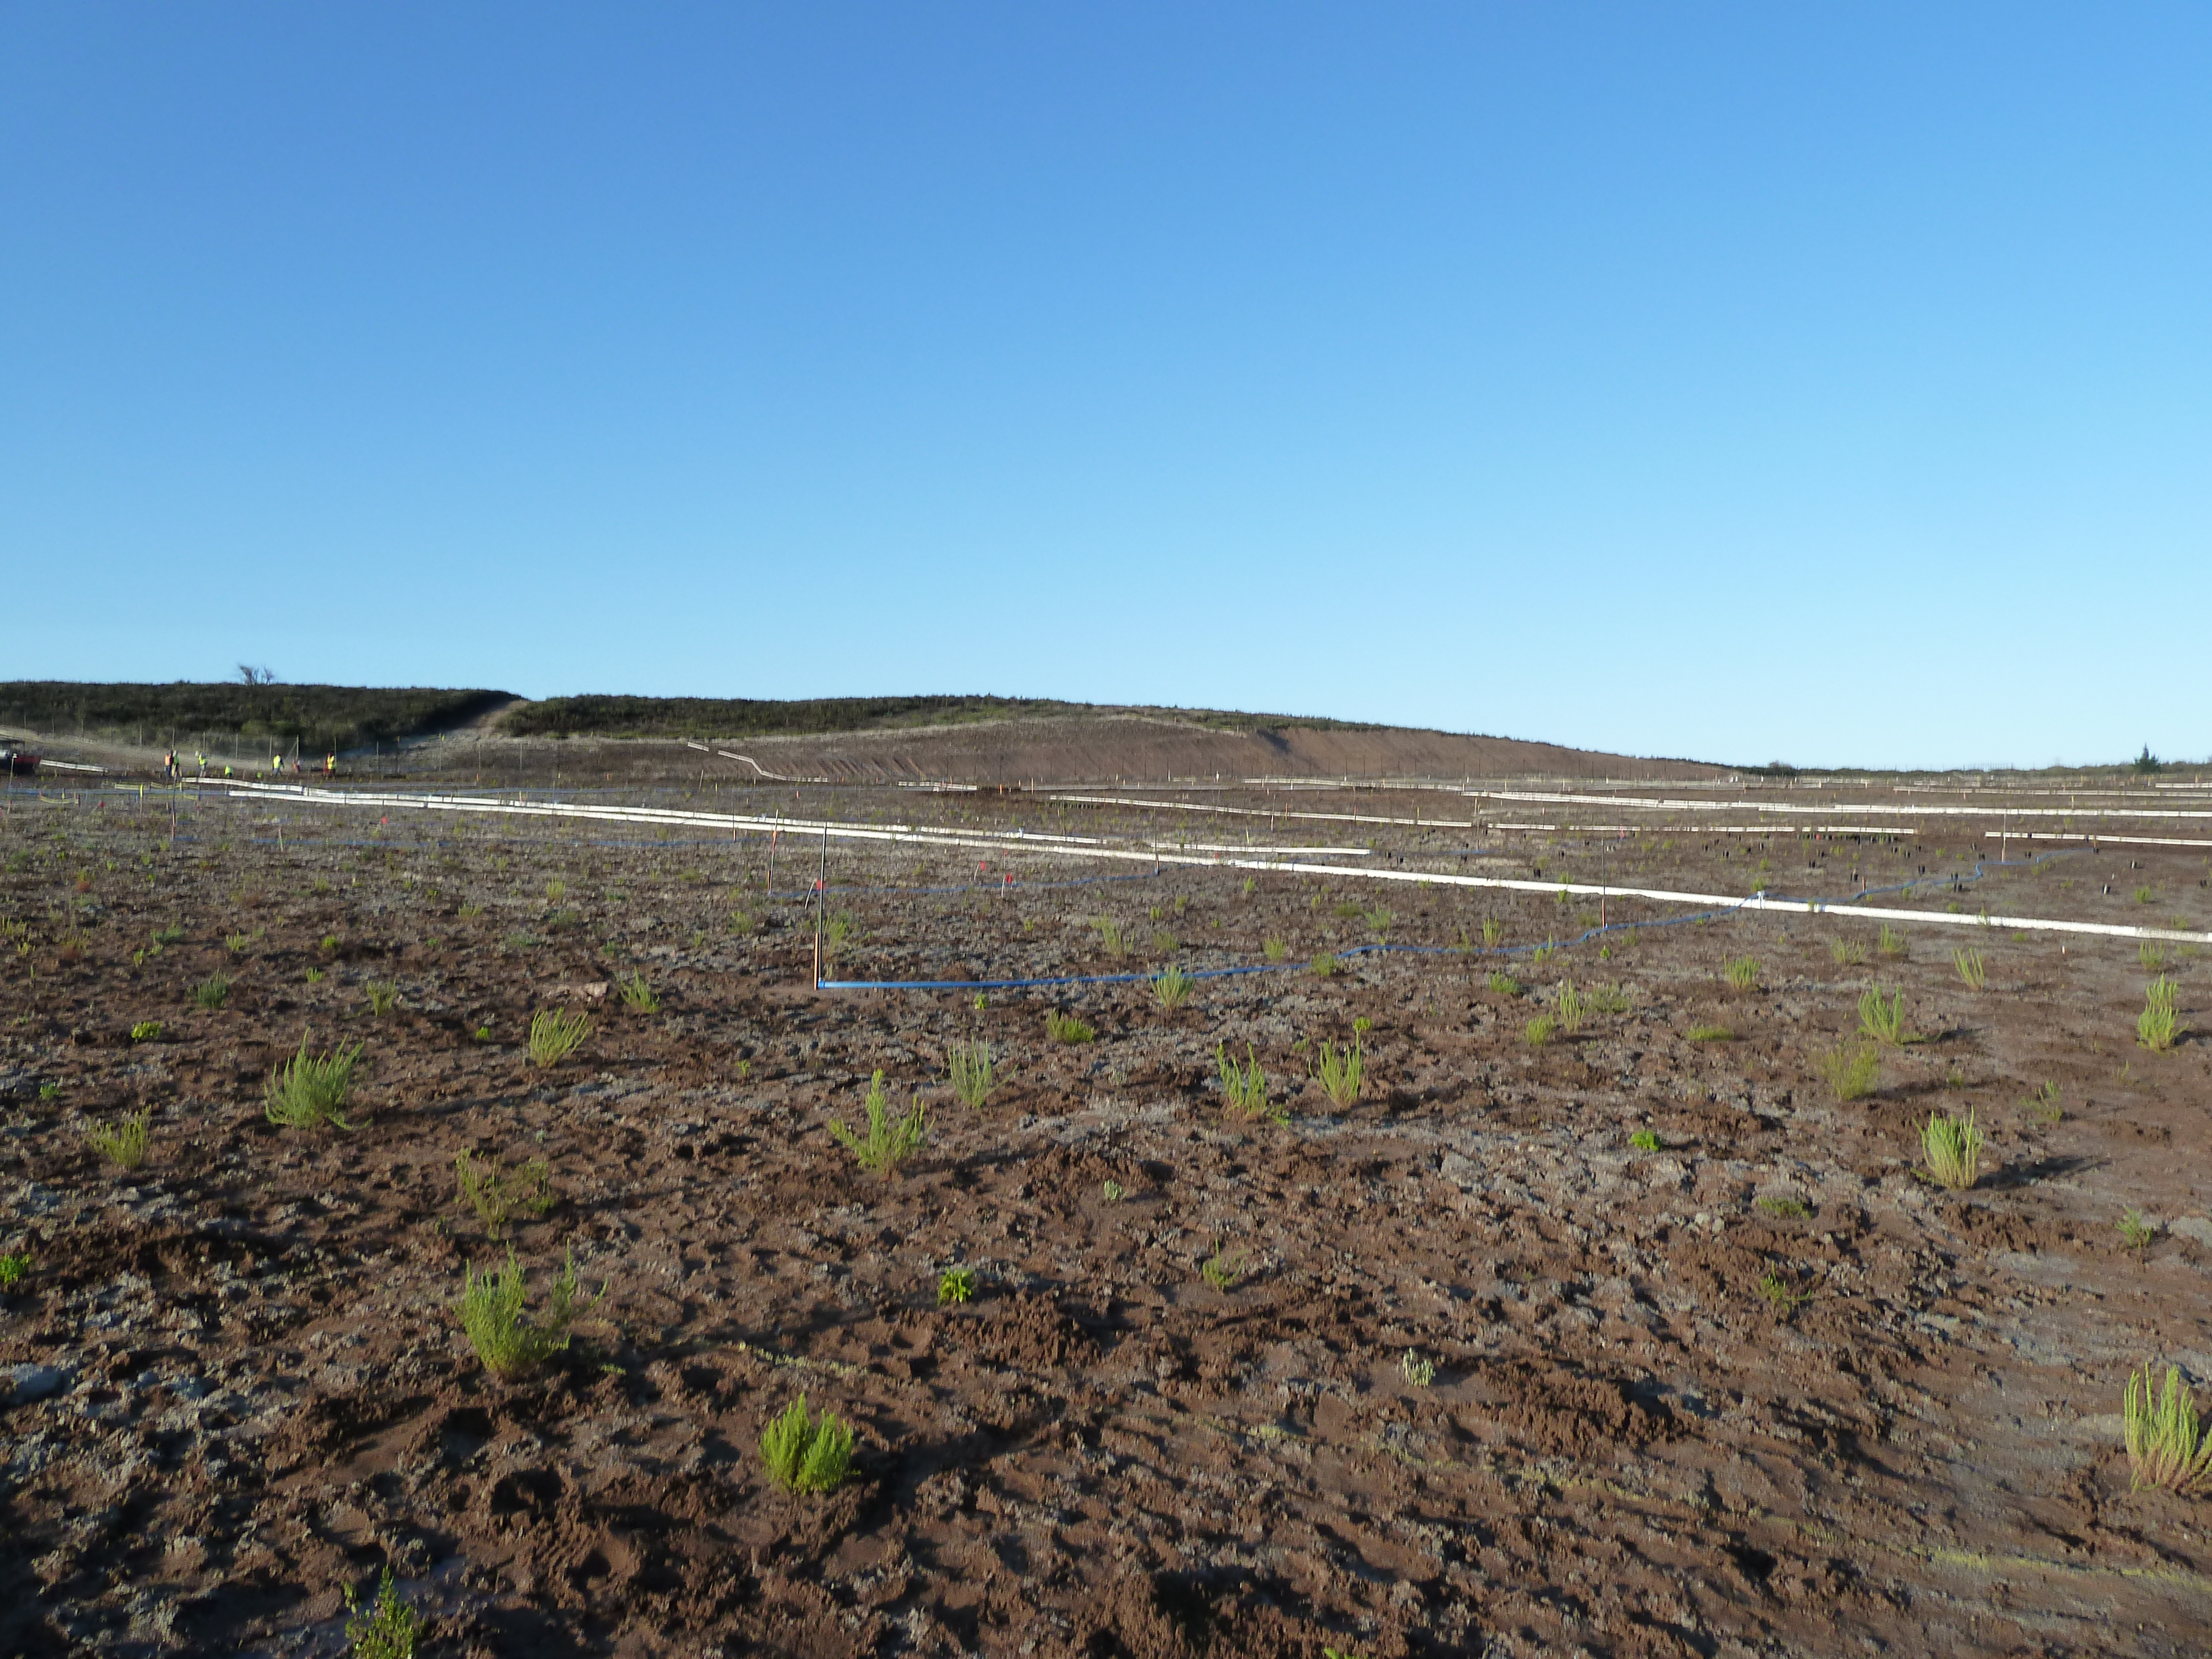
Habitat Restoration: Implementation
January 2013
Sand Gilia
June 2013
February 2013
7

Slide 5
FORA/Jurisdiction Property Transfer
Comprehensive Environmental Response Liability and Coordination Act (CERLA) vs. the Resource Conservation and Recovery Act (RCRA) Assurances
Protections afforded by Section 330, FY 93 NDAA indemnity
Coordinated Fort Ord risk management and insurance coverage issues
Deed restrictions, covenants and warranties
Property transfer Process and Action Item Checklist
9

Slide 6
Jurisdictions’ Pollution Legal Liability Insurance
Who renews Pollution Legal Liability coverage?
How much coverage?
Which parcels to cover?
Coverage for other public entities and developers cover?
9

