Slide 1


Fort Ord Reuse Colloquium Highlights
Economy, Education & the Environment on the former Fort Ord
Dec 12-13, 2013

Slide 2
PANEL 1: Economic Development & Innovation
Moderator:
Dr. Eduardo M. Ochoa
President, CSU Monterey Bay
Speakers:
Shyam Kamath, PhD
Dean, College of Business, CSU Monterey Bay
Larry Samuels
Principal, Samuels Associates, La Selva Beach, CA
Bud Colligan
Founder & CEO, South Swells Ventures, Santa Cruz CA

Slide 3
PANEL 2: Land Development & Job Creation
Moderator:
Jennifer Ott
Chief Operating Officer, Alameda Point, Alameda, CA
Speakers:
Peter Katz
Principal, Strategic Consulting Practice, Alexandria, VA
Mary Jo Waits
Director, Economic, Human Services, & Workforce Division, National Governor’s Association, Washington, D.C.
Craig Seymour
Managing Principal, RKG & Associates, Alexandria, VA

Slide 4
PANEL 3: Blight Removal, Remediation & Economics
Moderator:
Katie Timmerman
Senior Construction/Project Manager, CSUMB
Speakers:
Jim Musbach
Managing Principal, Economic and Planning Systems, Inc.
Lenny Seigel
Executive Director, Center for Public Environmental Oversight, Mountain View, CA
Bradley Guy
Asst. Professor, Sustainable Design Program, School of Architecture and Planning, The Catholic University of America, Washington DC

Slide 5
PANEL 4: Design Guidelines as Economic Catalyst
Moderator:
Victoria Beach
City Council Member, Carmel-by-the-Sea
Speakers:
Charles Bohl
Associate Professor & Director of the Masters in Real Estate Development and Urbanism, University of Miami’s School of Architecture, Miami, FL
Victor Dover
Principal, Dover, Kohl, & Partners, Coral Gables FL

Slide 6
PANEL 5: Form-based Regional Planning & Community Collaboration
Moderator:
Brian Congleton
Architect, Carmel-by-the-Sea
Speakers:
Bill Lennertz
Executive Director, National Charrette Institute, Portland OR
Stefan Pellegrini
Principal, Opticos Design, San Francisco CA
Doug Walker
President , Placewayss LLC, Boulder, CO

Slide 7
PANEL 6: National Monuments as Economic Engines
Moderator:
David Spaur
Monterey County Economic Development Director
Speakers:
Doug Farr
resident & CEO at Farr and Associates, Architecture and Urban Design, Chicago, IL
Jim Meadows
Past Executive Director, Presidio Trust, Presidio of San Francisco
Luther Propst
Founder, Sonoran Institute, Tucson, AZ

Slide 8
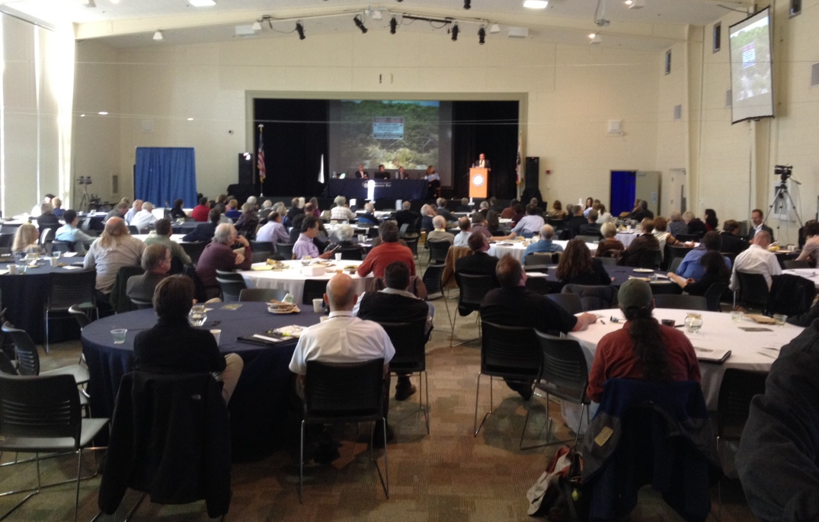
Thank you!

